Slide 1




Module 1.4b
Scratch Face Filter Activity
Living and Working with Artificial Intelligence
Source: Scratch Face Sensing Lab
Face Filter Activity adapted from the starter project available from the Scratch Face Sensing Lab https://lab.scratch.mit.edu/face/. Activity developed for the AI4GA (Artificial Intelligence for Georgia) project funded by National Science Foundation awards DRL-2049029 and DRL-2048502.
This work is licensed under the Creative Commons. Attribution-NonComercial-ShareAlike 4.0 International License. https://creativecommons.org/licenses/by-nc-sa/4.0/

Slide 2

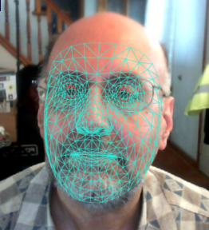
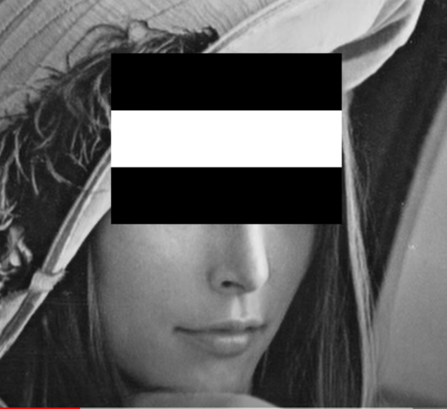
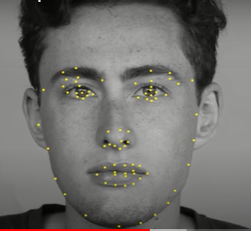
How do face filters work?
Explain these 3 steps.
1 2 3
Notes:
Bell Ringer ro review

Slide 3
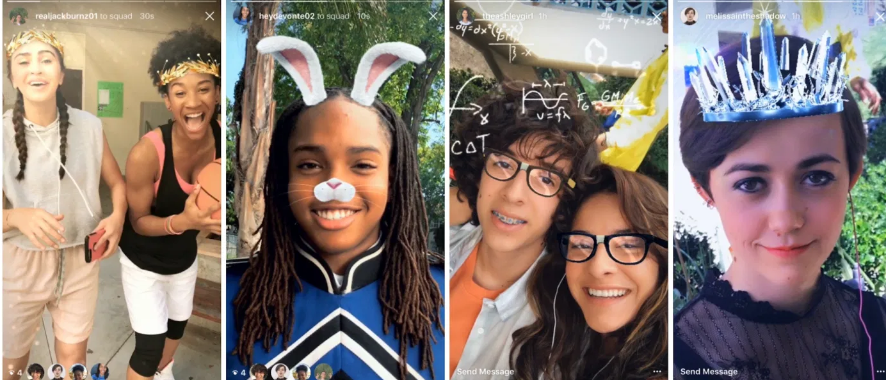

Slide 4
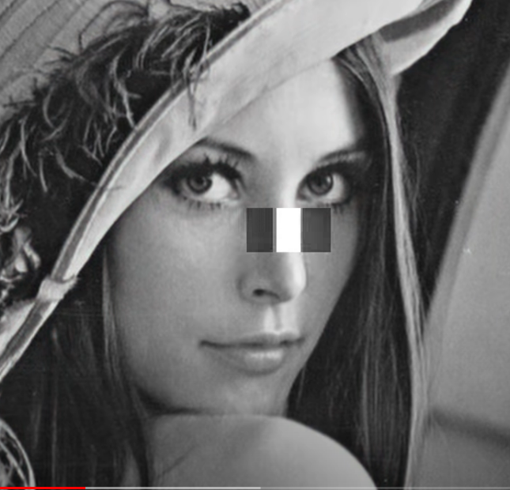
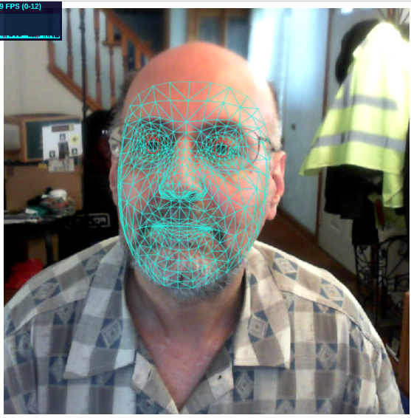
Now that we know how face and feature detection works, let’s use it to create our own filters!

Slide 5
Scratch Activity
Creating our own face filters
Gallery Walk at the End of Class

Slide 6

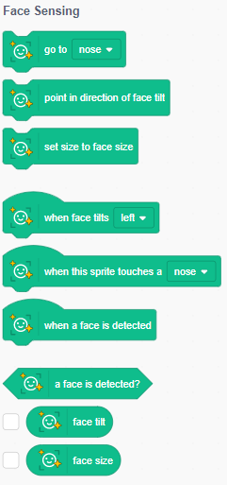
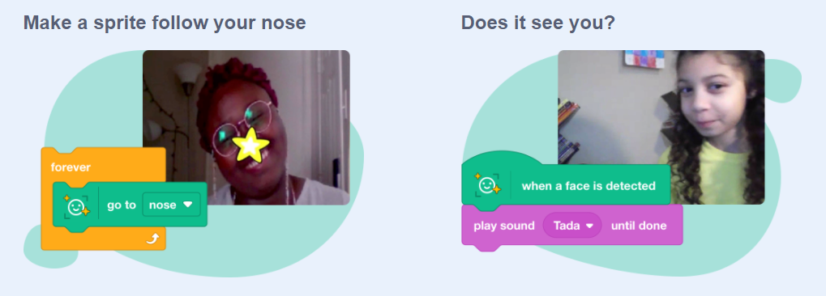
Face Sensing
Face Sensing - Scratch Lab

Slide 7
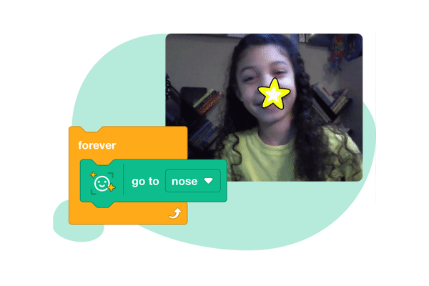
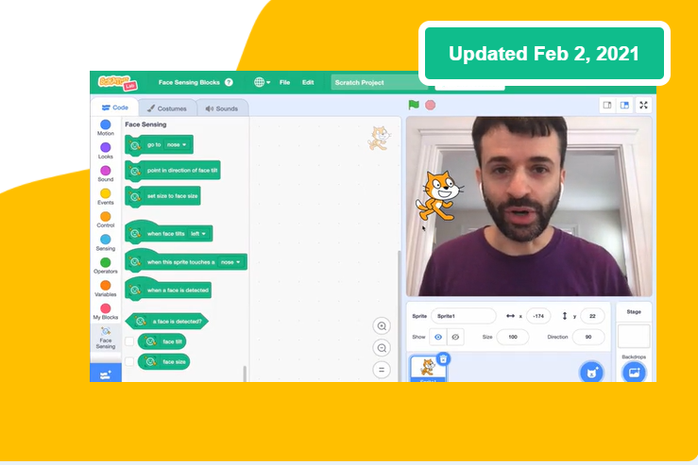
Video

Slide 8
Vocabulary
Sprite -> characters and objects we can control with code
Events -> action that cause something to happen (usually starts with the word “when”)
Responses -> how the sprites react to events

Slide 9
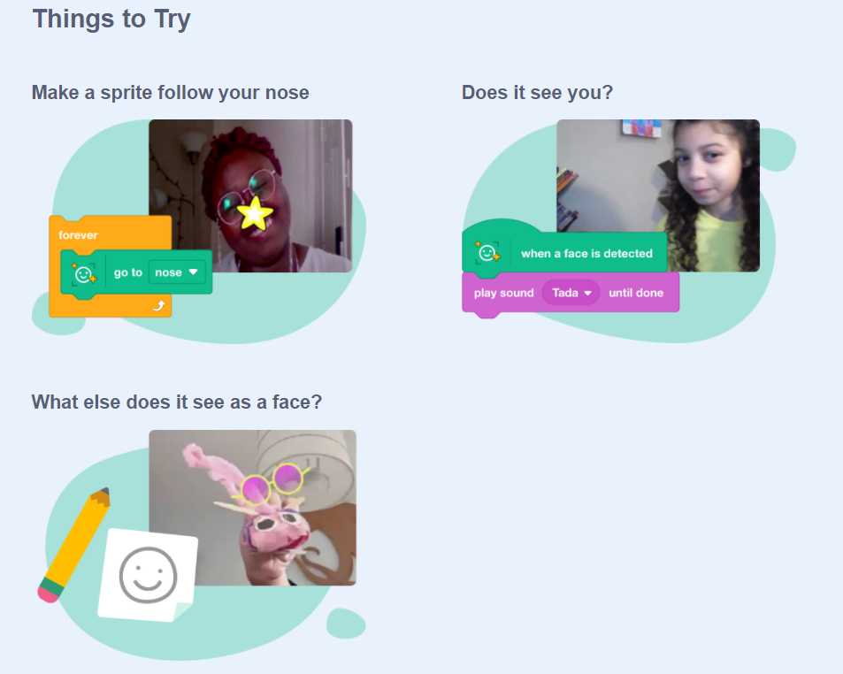
Try it out: https://lab.scratch.mit.edu/face/

Slide 10
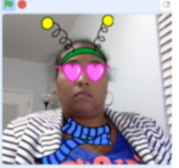
DIY - Face Filter

Slide 11
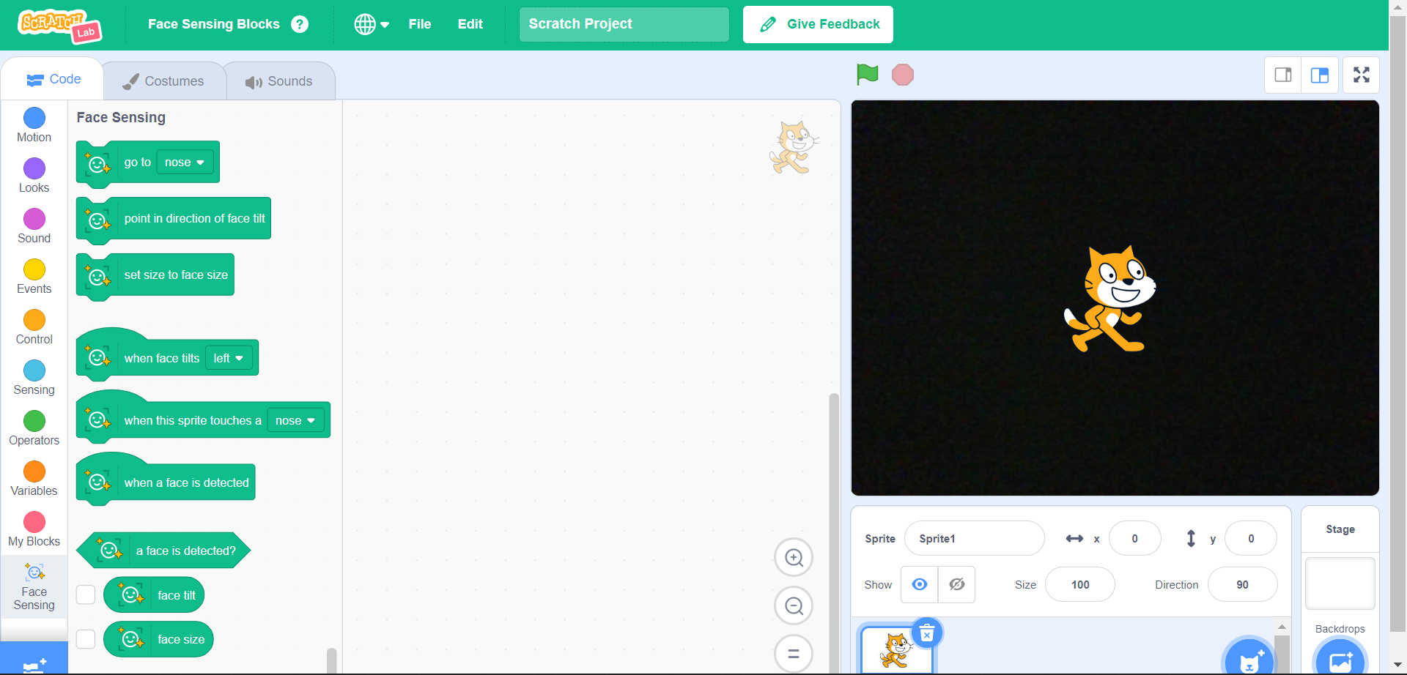
When you open Scratch, you must allow your camera.
If you do it correctly, you will see yourself on the stage (the right side of the screen.)
There will be an orange cat in the middle of the screen, as well.

Slide 12
The orange cat is a sprite. We can control sprites with code blocks and use them for our filters.
Let’s choose our own sprites. Delete the cat by clicking the little trashcan next to his icon.

Slide 13
Now click the little blue cat head to get some new sprites that you want to use.
There are hats, glasses, and plenty of other sprites to choose from.

Slide 14
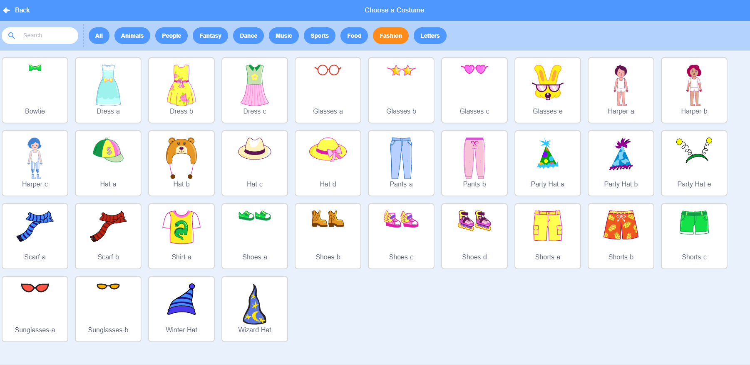
Head, eyes, and neck sprites are in the “fashion” category

Slide 15
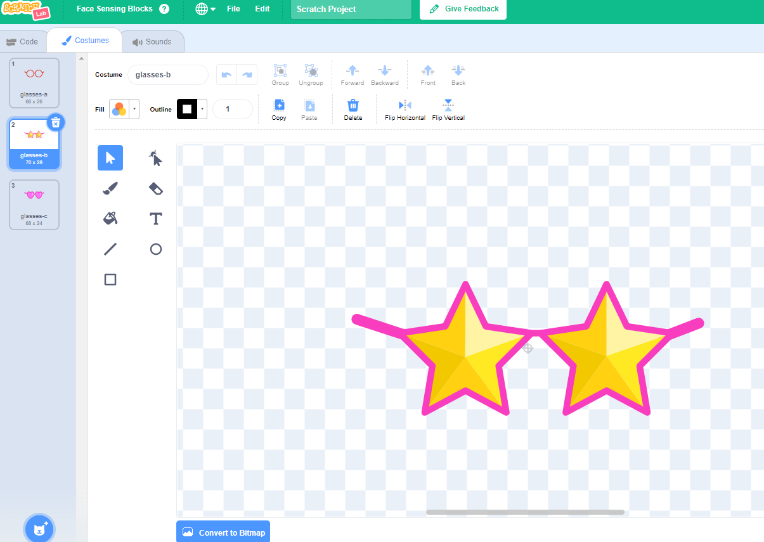
You can edit sprites by clicking the costumes tab and drawing on the sprites.
Add more costumes with the little blue cat head.
Don’t forget to click the “Code” tab when you are done editing.

Slide 16
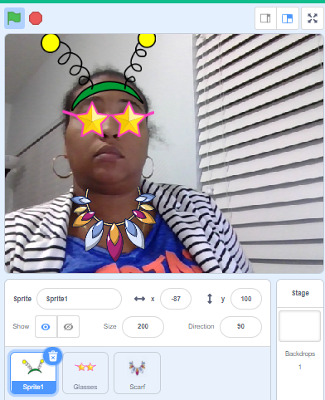

Now you try: Design a Basic Filter
Change the size and placement of sprites manually
You can drag and drop sprites to wherever you want.
When you finish, put your face in the camera to wear your filter.
*You can change the size as well.

Slide 17
What do you think:
Does the Basic Filter we made use face detection?
How do you know?

Slide 18
Answer:
The basic filter does NOT. We can tell, because the objects do not follow the face.
However, we can use the face sensing blocks to add face detection to our scratch project.
Let’s level up!
Notes:
Delete the green block to find the answer

Slide 19
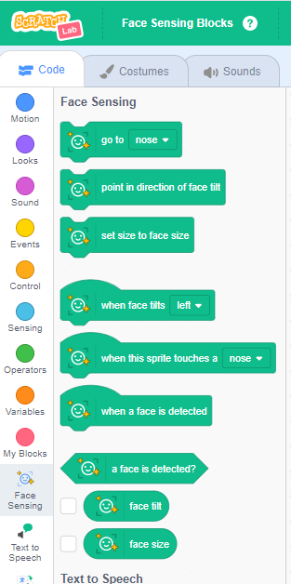
Programming our Filter using
Face Sensing Blocks
Step 1
Get Filter to attach to face

Slide 20
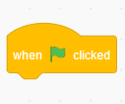
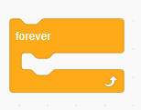
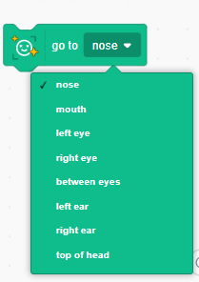
Find the yellow event block:
Find the dark orange control block:
And the green face sensing block:
You need the green flag and forever blocks.
The face sensing block has an arrow to drop down. Choose any option you want.

Slide 21
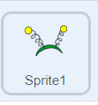
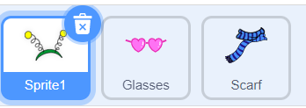
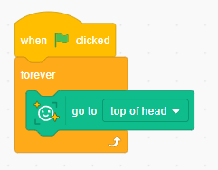
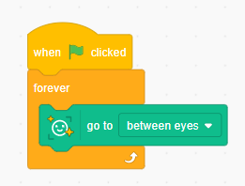
The code blocks snap together! :)
Just click a sprite, then drag and drop blocks into the white space in the center.
Example code pieces to try:

Slide 22
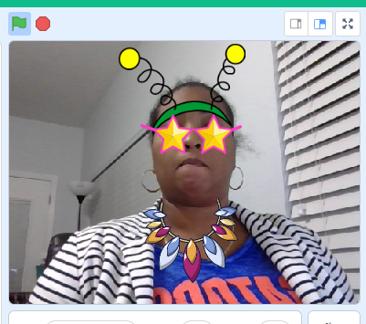
Level 1 - Intermediate - Change Costume

Slide 23


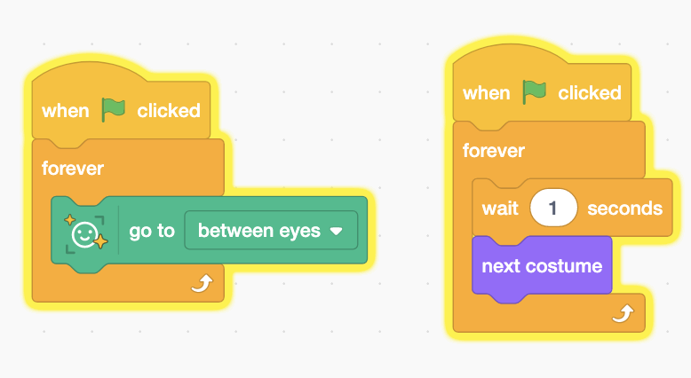
Intermediate - level 1 - Change Costumes
Add these 2 new blocks INSIDE of the forever block loop
1 second is actually a long time…
Try using 0.5 or 0.2 seconds
What happens when you run this program?

Slide 24
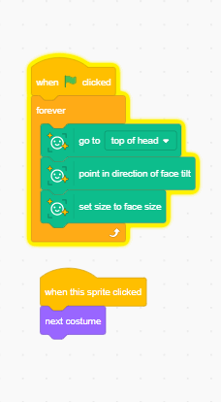
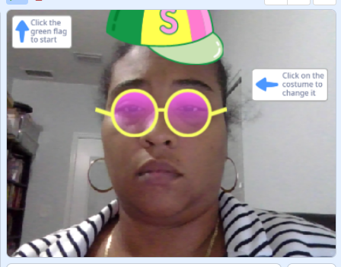
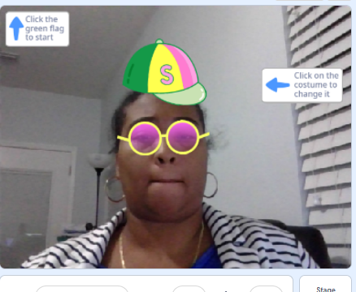
Try this code to make the filter change size or “tilt” with your head.

Slide 25
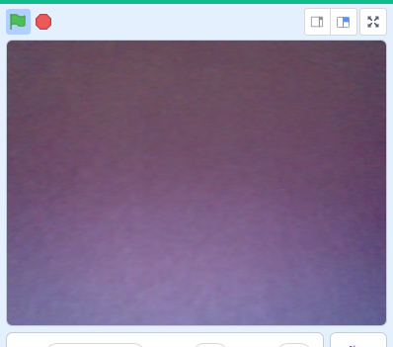
Advanced Customization
Only show filter when face is present

Slide 26
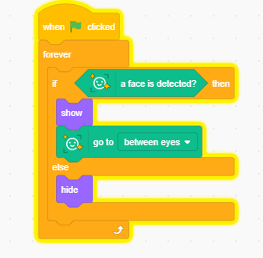
Only shows filter when face is present.

Slide 27
Once you finish playing in scratch, turn in your project file or link:

